Slide 1
Project 0
Long Nguyen
https://github.com/LongNguyen1452/Project0

Slide 2
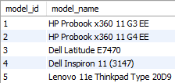
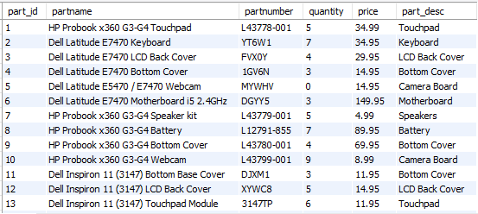
Mysql tables

Slide 3
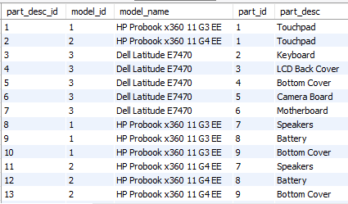
Associate table
Links the models and parts table together
Determines which parts belong to which laptop

Slide 4

Connection Driver / statement

Slide 5
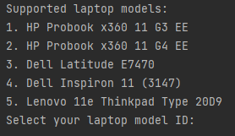
First query
Selects all the laptop models and requests an input

Slide 6
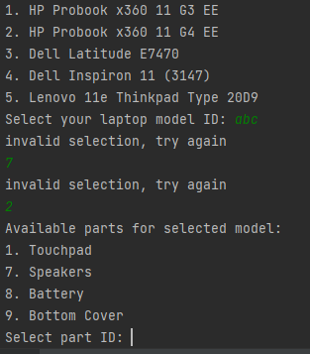
Input check
Checks if the input is a valid entry
Only accepts IDs displayed
Requests re-entry if input is invalid
If entry is valid, proceed to next step

Slide 7
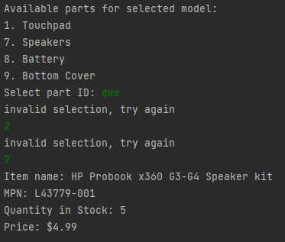
Input check (part 2)
Displays available parts for the selected laptop model
Will require a valid input again to proceed
After valid input, displays the exact part along with the descriptions for the item

Slide 8
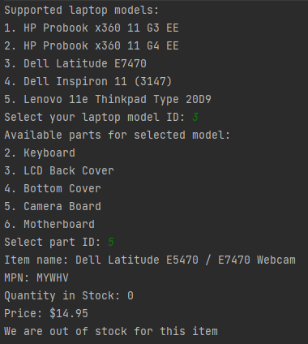
Quantity of 0
Checks and displays if quantity for selected item is 0

